Slide 1
Updates 6/23/20
Akash Levy

Slide 2
Overview
Per-chip optimization methodology
Retention plan
Results on 3 chips
Pulses vs. cycling plot

Slide 3
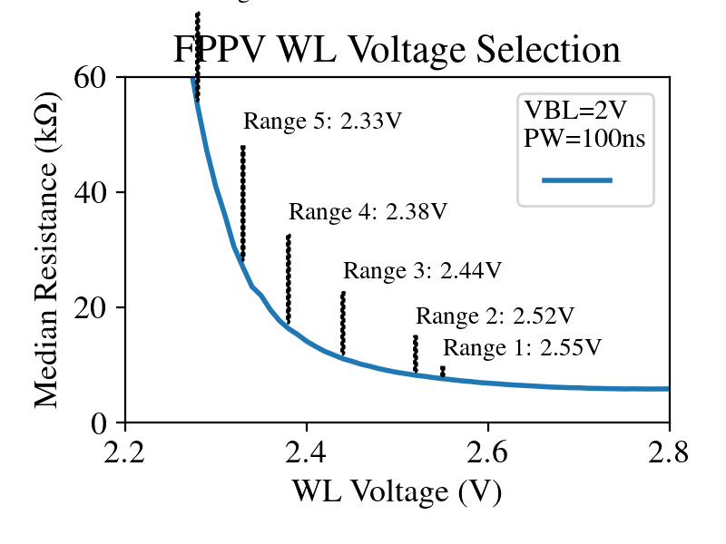
Per-chip optimization
Seems that there are threshold voltage differences across devices
Makes sense since deposition uniformity issues possible during fabrication
But only need to adjust FPPV WL voltages to account for differences
Just do FPPV WL sweep and use new voltages

Slide 4
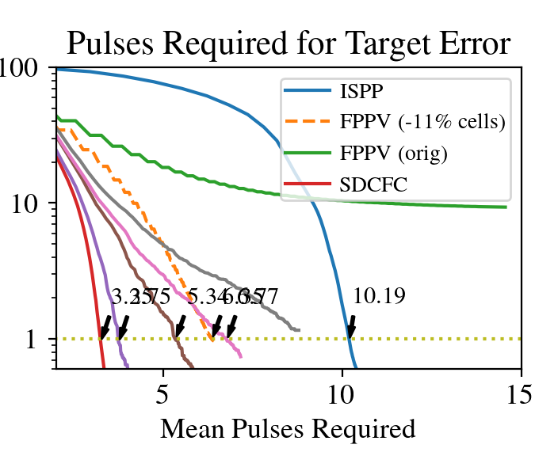
Pulses vs. Cycling
Results on chip 2:
Red curve: 300 cycles
Purple curve: 1k cycles
Brown curve: 6k cycles
Pink curve: 11k cycles
Gray curve: 20k cycles

Slide 5
Results on 3 chips
 | SDCFC | ISPP | FPPV (w/removal) | SDCFC (10k cycled) | ISPP (10k cycled)
Chip 1 | 3.52* | 9.19 | 6.43
Chip 2 | 3.25* | 10.19 | 6.35 | 6.29 (to fix) | 10.65
Chip 3
Chip 4
* Without change

Slide 6
Retention plan

